Slide 1

ATTENDANCE MANAGEMENT SYSTEM USING FACE RECOGNITION
GUIDED BY,
PROF. HUSAIN AHAMED P
SUBMITTED BY
BINCY K BABU
TCR19MCA013

Slide 2
EXISTING SYSTEM
Attendance maintenance is an important task in all the institutions to check the performance of students.
Managing attendance can be a tedious job when implemented by traditional methods like calling out roll numbers of students or by taking signatures.
Effort and time consuming task.

Slide 3
PROPOSED SOLUTION
The students face id are stored and hence by the help of the system the image can match faces and thus mark the attendance automatically.
This system uses the face recognition approach for the automatic attendance.
The images of students are uploaded, detect the faces in images, compare the detected faces with the database and thus mark the attendance.

Slide 4
FUNCTIONAL REQUIREMENTS
This section specifies all the fundamental action of the software system.
Class 1: ADMIN
Functional requirements 1.1
Title :Department Management
Description: Admin can add /view/delete Departments
Functional requirements 1.2
Title :Course Management
Description Admin can manage Course based on departments

Slide 5
Functional requirements 1.3
Title :Student Management
Description: Admin manages the Students
Functional requirements 1.4
Title :View Attendance
Description: Admin can view Attendance list
Class 2: CAMERA
Functional requirements 2.1
Title :Face Recognizing and marking attendance
Description: : The camera module recognize the face of a students and mark the attendance of that corresponding recognized student.

Slide 6
NON FUNCTIONAL REQUIREMENTS
Error handling:
The system shall handle expected and non-expected errors in a way that prevent loss in information.
Performance Requirements
Speed of the system is an important constraint.
Security Requirements
System will use secured database and shall permit only administrator/owner to modify the contents.

Slide 7
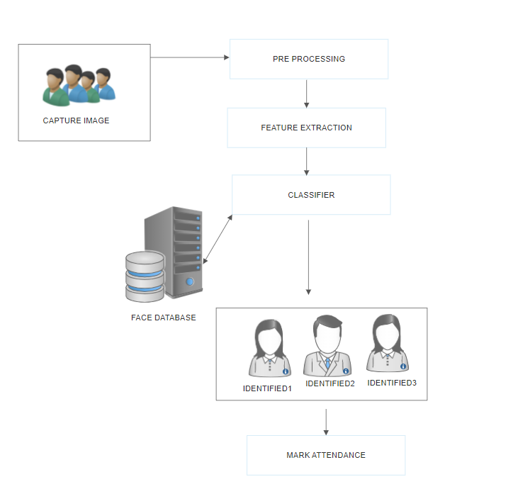
ARCHITECTURE DIAGRAM

Slide 8
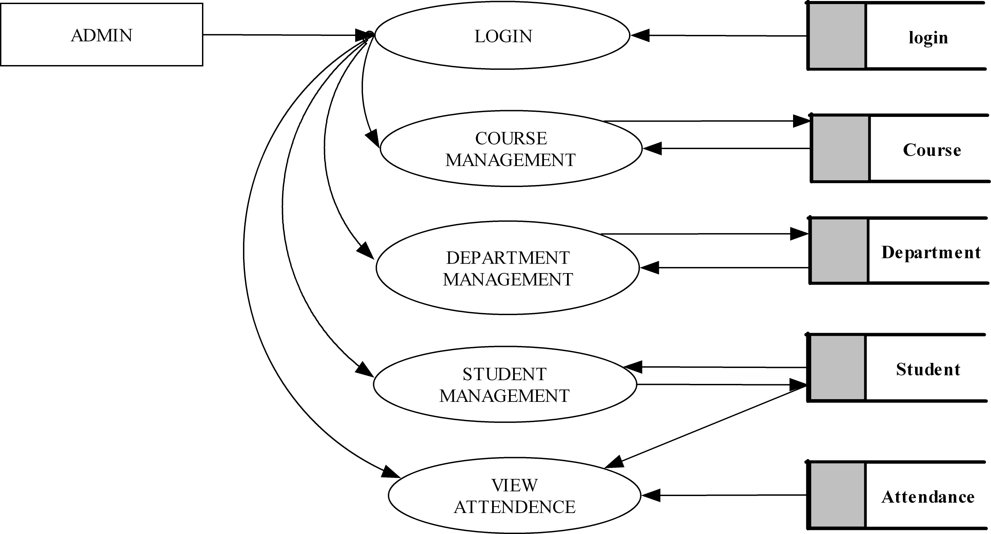
DATA FLOW DIAGRAM
ADMIN

Slide 9

CAMERA

Slide 10
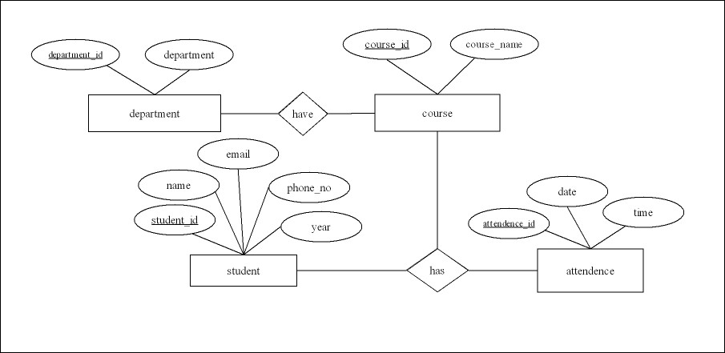
ER DIAGRAM

Slide 11
BLOCK DIAGRAM
CAPTURE IMAGE
PRE PROCESSING
FEATURE EXTRACTION
FACE DATABASE
CLASSIFIER
IDENTIFY FACES
MARK ATTENDANCE

Slide 12
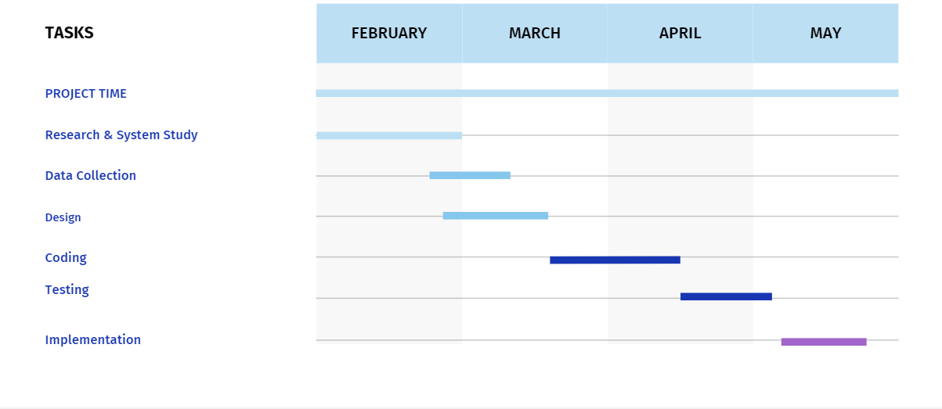
PROJECT PLAN
Feb12-24
Feb25-mar10
Mar11-23
Mar24-apr15
Apr16-may2
May3-may10

Slide 13
THANK YOU

